Slide 1
CSE437 Project
Loan Prediction using Svm, Naive bayes and Random Forest
Section 02

Slide 2
Introduction
What is our objective?

Slide 3
Models
Gaussian Naive Bayes
Random Forest
SVC

Slide 4
Data Set Description
Total 13 Variables
8 categorical
4 continuous
1 variable for loan ID

Slide 5
Data Set Description
Loan_ID *Gender
Married *Dependents
Education *Self_Employed
ApplicantIncome *CoapplicantIncome
LoanAmount *Loan_Amount_Term
Credit_History *Property_Area
Loan_Status

Slide 6
Libraries
numpy
pandas
classification_report
confusion_matrix
MinMaxScaler
train_test_split
SVC
GaussianNB
RandomForestClassifier

Slide 7
Data Preprocessing
Drop Unnecessary Variables
Data Imputation
Categorical Variables
Numerical Variables
One-hot Encoding
Remove Outliers & Infinite values
Skewed Distribution Treatment
Features Separating
SMOTE Technique
Data Normalization
Splitting Data Set

Slide 8
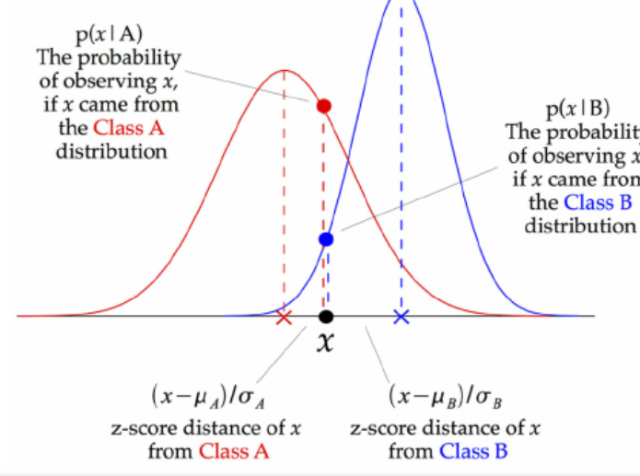
Model: Gaussian Naive Bayes
Continuous valued features distributed according to Gaussian(Normal) Distribution.
Helpful for continuous values.
Class mean calculated at z-score points.
The class mean divided by the standard deviation
of that class.

Slide 9
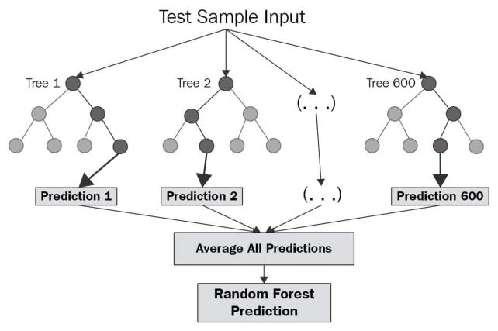
Model: Random Forest
Can handle missing values
Good with large datasets
Can handle both Classification and Regression
Steps:
1: Pick any K data points at random from the training set
2: Build the decision tree associated to these K data points
3: Repeat STEPS 1 and 2 N times, where N = number of trees.

Slide 10
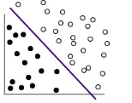
Model: Support Vector Machine
SVM works by mapping data to a high-dimensional feature space so that data points can be categorized or linearly separable.
The data are transformed in such a way that the separator could be drawn as a hyperplane.
Following this, characteristics of new data can be used to predict the group to which a new record should belong.

Slide 11
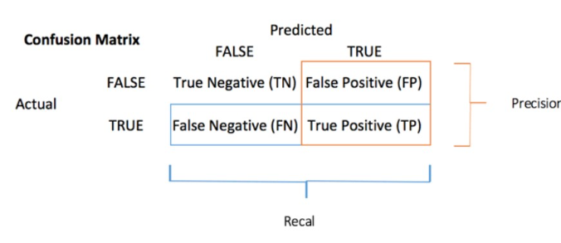
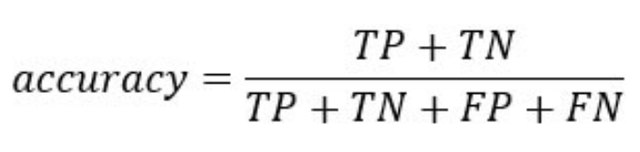
Result
Accuracy_score
accuracy score for a set of predicted labels
Returns fraction of correct prediction
Returns number of correct prediction
Confusion Matrix

Slide 12
Result
Classification Report
TN / True Negative: the case was negative and predicted negative
TP / True Positive: the case was positive and predicted positive
FN / False Negative: the case was positive but predicted negative
FP / False Positive: the case was negative but predicted positive

Slide 13
Result
Precision — What percent of your predictions were correct?
Precision = TP/(TP + FP)
Recall — What percent of the positive cases did you catch?
Recall = TP/(TP+FN)
F1 score — What percent of positive predictions were correct?
F1 Score = 2*(Recall * Precision) / (Recall + Precision)

